Slide 1
Illinois workNet
Volunteering – Good for Job Seekers and Business
College Changes Everything Conference
July 2015

Slide 2
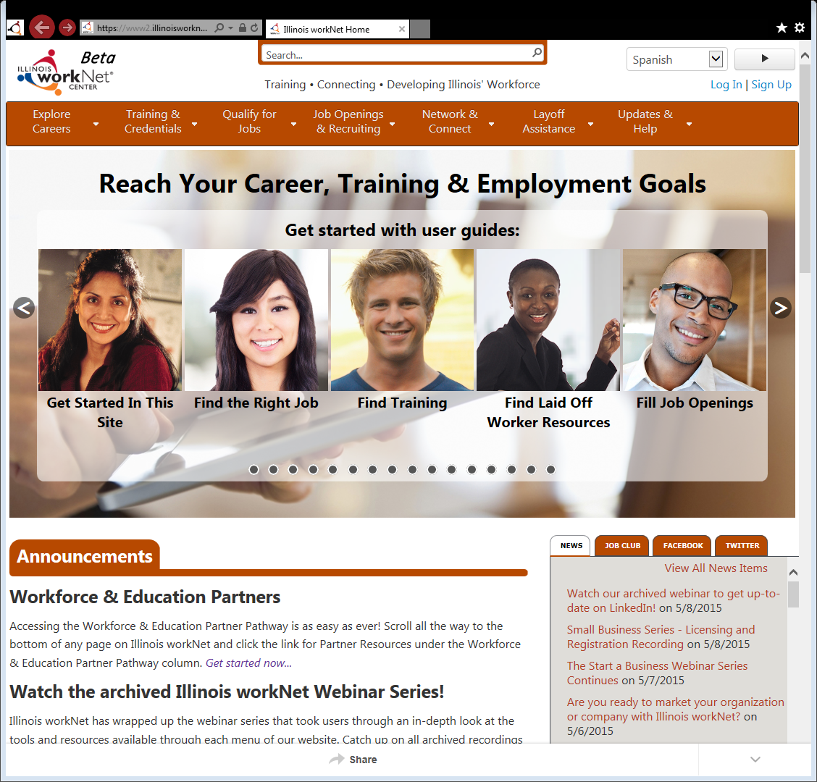
Illinois workNet
https://www.illinoisworknet.com/Volunteering
Goal: connect individuals, employers, and education, workforce and community partners to career planning, education and training, and employment resources and tools.
The portal connects people to local and statewide in-person and online services.

Slide 3
Target Audiences
https://www.illinoisworknet.com/Volunteering
While catering to all of our users, we also connect them.
Individuals: job seekers, ex-offenders, laid off workers, students, mature workers, persons with disabilities, veterans, etc.
Employers: ALL
Workforce Partners: Faith-Based Organizations, Community-Based Organizations, State Agencies, Community Colleges, and more!
Workforce & Education Partners
Employers
Individuals

Slide 4
Community Service/Volunteering & You
https://www.illinoisworknet.com/Volunteering
Higher odds of finding employment
Build skills/gain experience
Stay engaged in the work world
Build your professional network
Increase self confidence
Face new experiences
Make a difference in your community
Use, build and grow knowledge, skills and interests.
New to the job market - boost your resume.
Going through a career transition - fill employment gaps and network.
Boost resume with knowledge & skills from community service/volunteering
Feel great while helping others!!

Slide 5
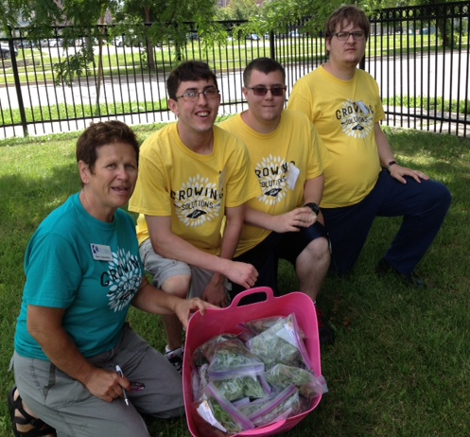
Resources for Training
https://www.illinoisworknet.com/Volunteering
Illinois workNet offers a range of tools and resources for training volunteers in career preparation and job search services:
FREE Online Resume Builder
Skill & Interest Surveys
Career Exploration
Employment 101
Job Skill Guides
Digital Literacy Guides
Articles, Resources, & Videos

Slide 6
Faith-Based Volunteering & Illinois workNet
Become an Illinois workNet Partner
No Cost Community Outreach
Find Information & Guidance for Career Preparation & Job Search Services
Attend FREE Webinars
Notes:
Service Finder
Event Calendar
Illinois workNet provides a continuum – connecting volunteers to faith-based organizations and then FBO to Employer
Assessments
Webinars

Slide 7
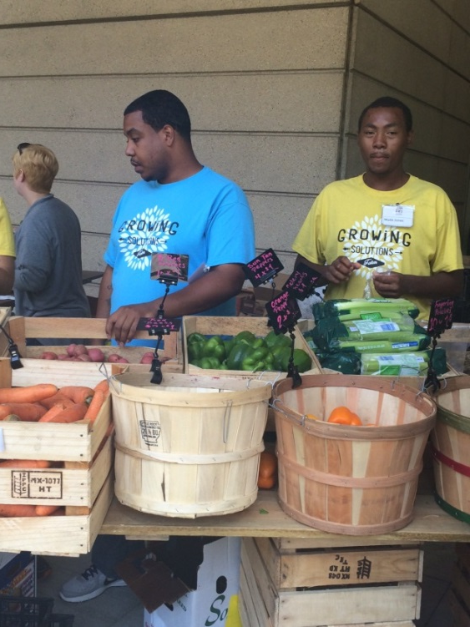
Employers Connect to Partners and Individuals
https://www.illinoisworknet.com/Volunteering
Stay Connected
Find Local Partners That Need Volunteers
Provide Individuals with Opportunities to Learn
Engage In Your Community
Notes:
Connect with local partners through the Service Finder
Opportunities Example: Work-Based Learning Opportunities – example: bringing the group that is working with the FBO to a site for a day

Slide 8
Next Steps
https://www.illinoisworknet.com/Volunteering
Subscribe to Illinois workNet News
http://www.illinoisworknet.com/partnernews
Register for Upcoming Volunteer Webinars
http://illinoisworknet.eventbrite.com/
Bookmark Illinois workNet “Guide for Helping Individuals” page for resources to help your volunteers achieve their career, employment & training goals.
Become an Illinois workNet Partner!
www.illinoisworknet.com/BecomeAPartner

Slide 9
Thank You – Contact US
Visit: www.illinoisworknet.com
Email: info@illinoisworknet.com
Monday – Fridays
8:00 am – 4:30 PM
Emails are checked and responded to each business day.

